Slide 1






[0, 1]
Cust. Segment 14
DM type 1
[0, 1]
Cust. Segment 7
DM type 2
[0, 1]
Cust. Segment 4
DM type 3
Cust. Segment 1

Slide 2
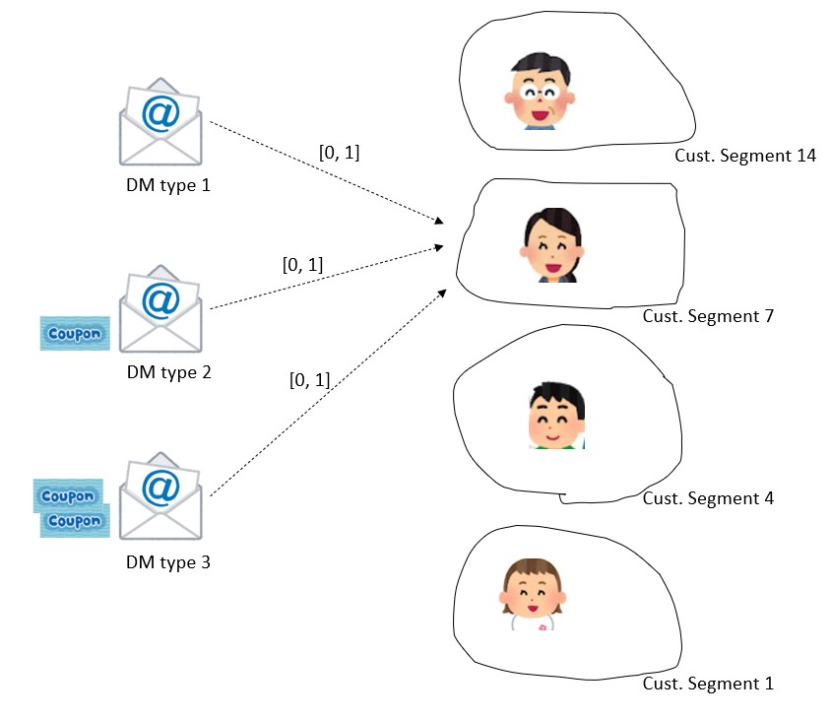


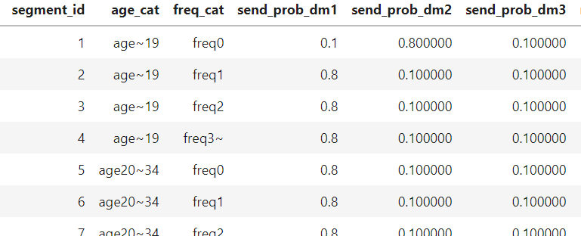
Python Pulp library
DM promotion budget
Optimizer of mail distribution to maximize the conversions
Best mail distribution plan
Revenue from more purchases

Slide 3
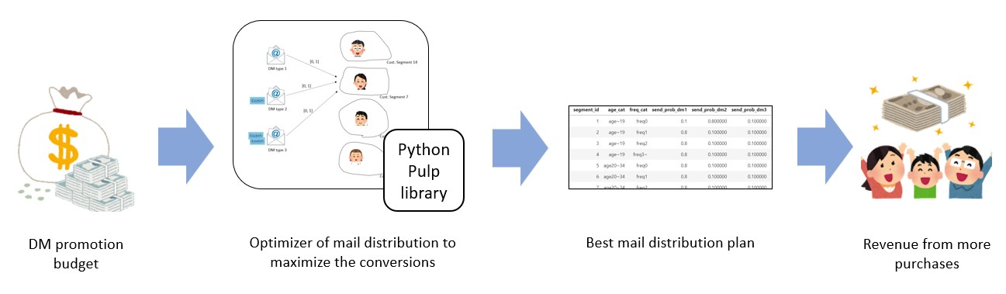


Budget $5,000
Budget $10,000
Budget $15,000

